Slide 1
1. semester projekt - prøveeksamen
General feedback
Godt ☺
Men 😐

Slide 2
Use cases
How to find / determine use cases?
How to test use cases?
When the use cases are found, start with an overview (represents the total functionality af the system)
Brief / casual format (when and how many)?
Fully dressed format – rules?

Slide 3
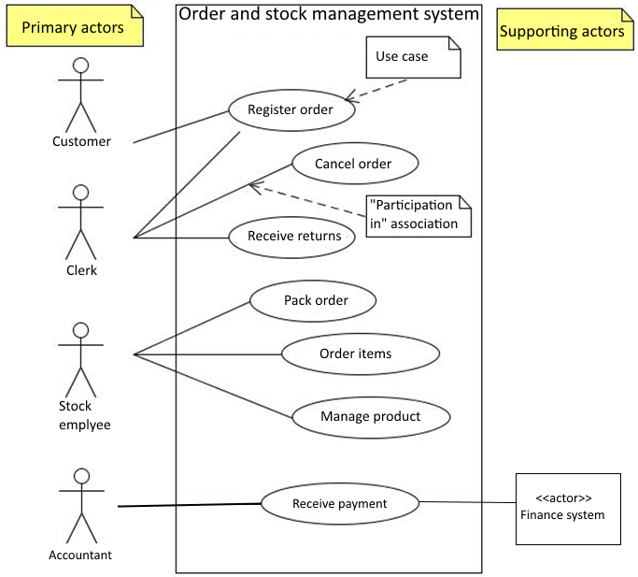
Use Case Diagram for the order and stock management system
A graphical model that illustrates the names of the use cases and actors, and the relationship between them
”A common exception to one use case per goal is to collapse CRUD (create, retrieve, update, delete) seperate goals into one CRUD use case, idiomatically called Manage <X>.” [Larman p. 87]
Larman chap. 6
3

Slide 4
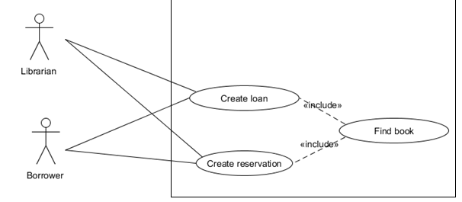
Use Case Diagram – Relating Use cases
Relating Use Cases [Larman] chap. 30
Partial behavior that is common across several use cases can be described in a subfunction-level use case and related to user-goal level use cases by a <<include>> relation:
Example of <<include>> in use case description cf [Larman] p. 494
(Don’t overuse!!!!)
4

Slide 5
Use cases
Use Case driven development
Prioritering
Foretag prioritering af use cases – og følg den
Brug Larman s. 130 – kriterier:
Risk (Technical complexity, ..)
Coverage – all parts of system covered early
Criticality – high business value
5

Slide 6
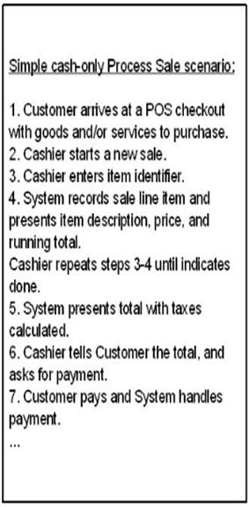
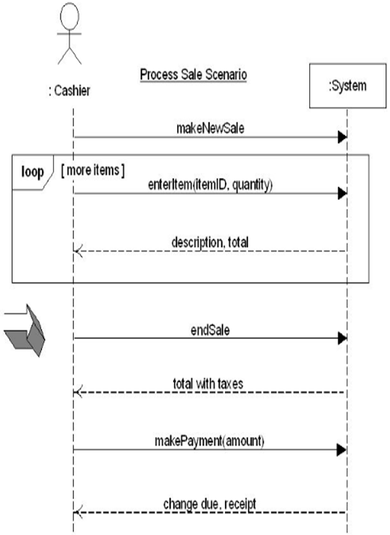
Traceability SD artifacts Use case and derived System Sequence Diagram
Fig. 10.3

Slide 7
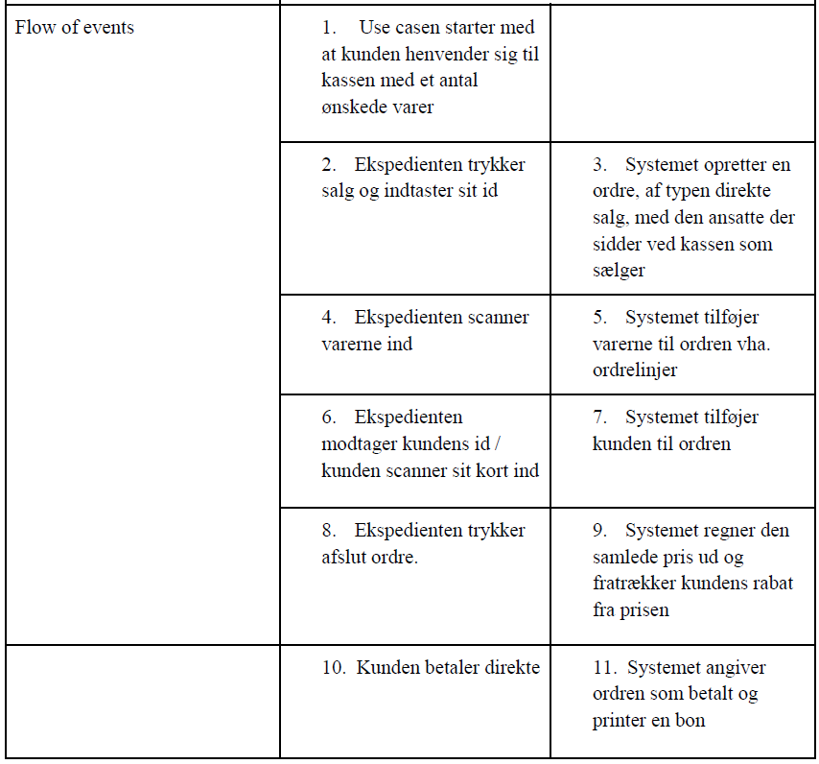
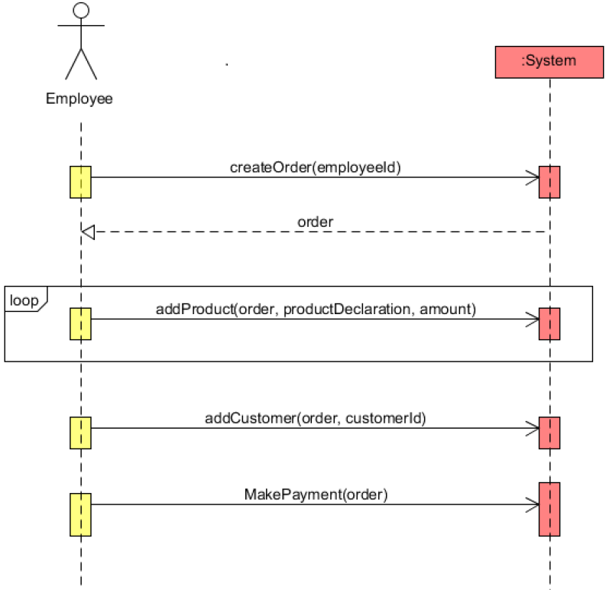
Traceability SD artifacts
Traceability: Fully dressed -> SSD
Notes:
SW project

Slide 8
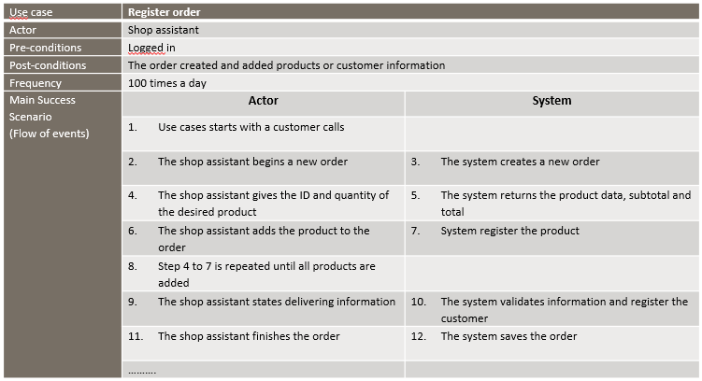
Fully dressed use case description
Now with loop!
Notes:
SW project

Slide 9
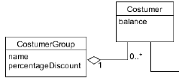
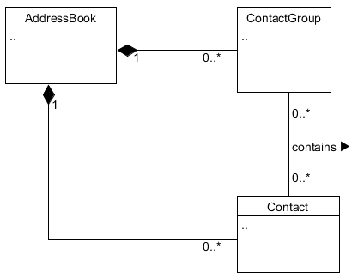
Domain model
Too many aggregations
Use only if obvious
Larman p. 264: "Composition Over Aggregation"
Notes:
SW project

Slide 10
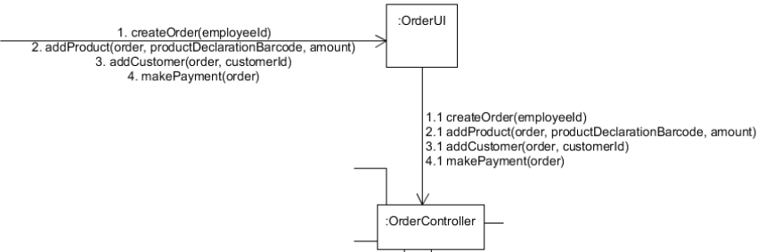
Traceability SD artifacts
Traceability: SSD -> interaction diagram
Notes:
SW project

Slide 11
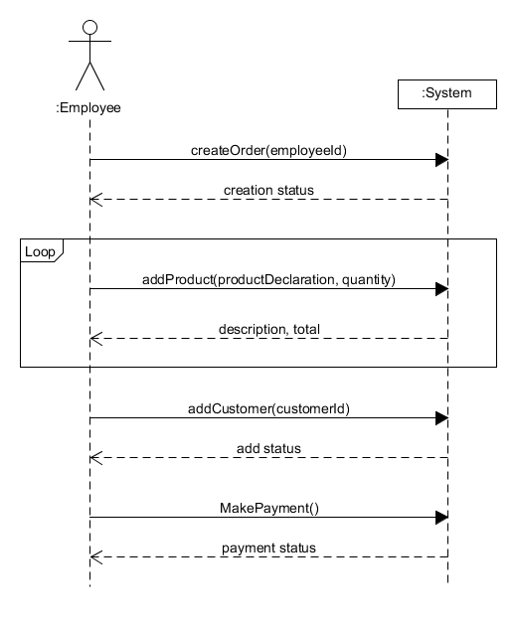
System Sequence Diagram (SSD)
Consider differences!
Notes:
SW project

Slide 12
Operation contracts
Name (Operation): Operation name and parameters
Cross References (use cases): reference to the use case
Precondition: Noteworthy assumptions about the state of the system or objects in the domain model before execution of the operation.
Postcondition: The state of the objects in the domain model after completion of the operation.
Operations contract
Operation: addLineItem (itemID, quantity)
Use-cases: Process sale
Precondition: A Sale instance (object) has been created
Post conditions:
A SalesLineItem instance (object) sli was created
sli was associated with the current Sale
sli.quantity became quantity (attribute modification)
sli was associated with a ProductSpecification (object), based on itemID match (association formed).

Slide 13
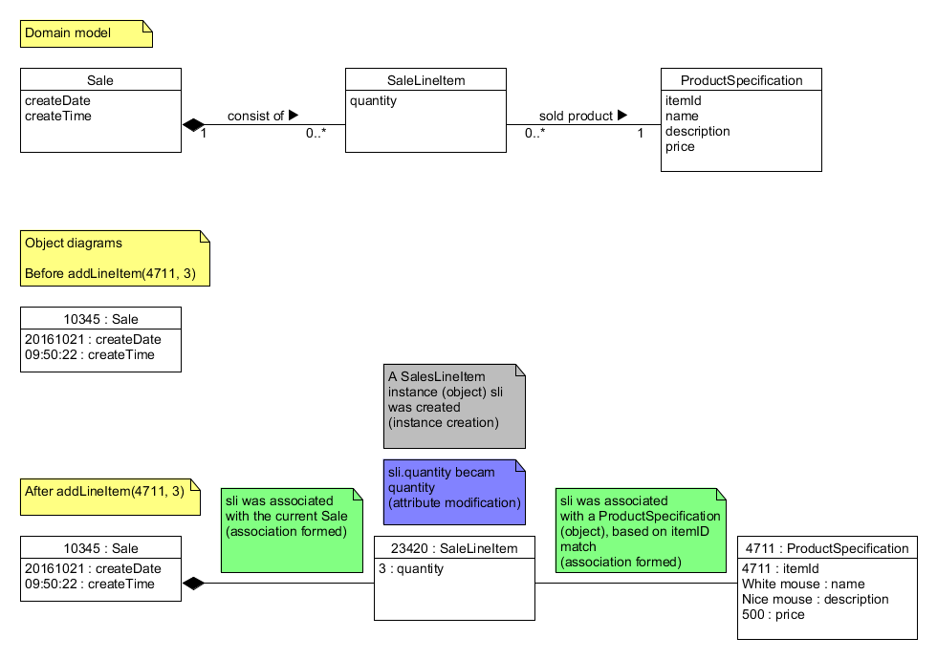
Example of operation contract
Before and after (postcondition) the operation: addLineItem(4711, 3)

Slide 14
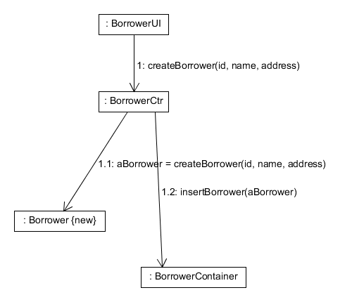
Communication diagram
Consider notation and create responsibility!
Notes:
SW project

Slide 15
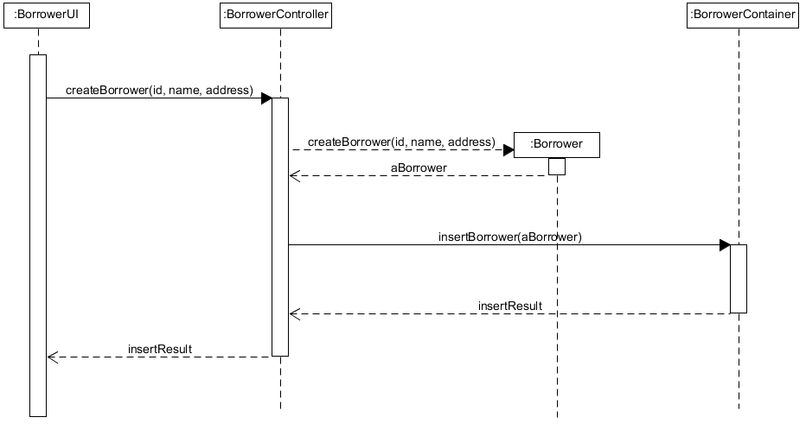
Sequence Diagram
Use either Communication or Sequence Diagram
Notes:
SW project

Slide 16
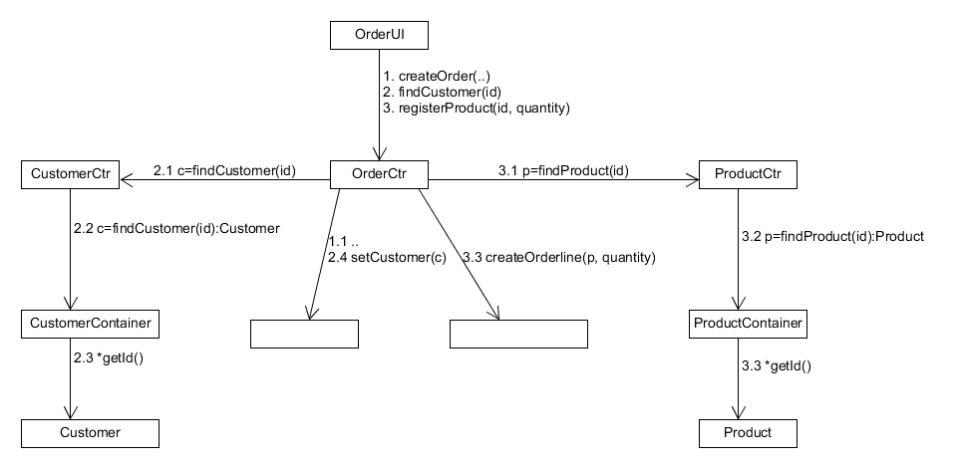
Low Coupling - reuse of controllers
How can you support low dependency between the system components/classes
How can you promote reuse?
We gain low coupling by reusing the CustomerCtr
..
..
and the ProductCtr
16
Litt: larman kap 15, 16 og 19

Slide 17
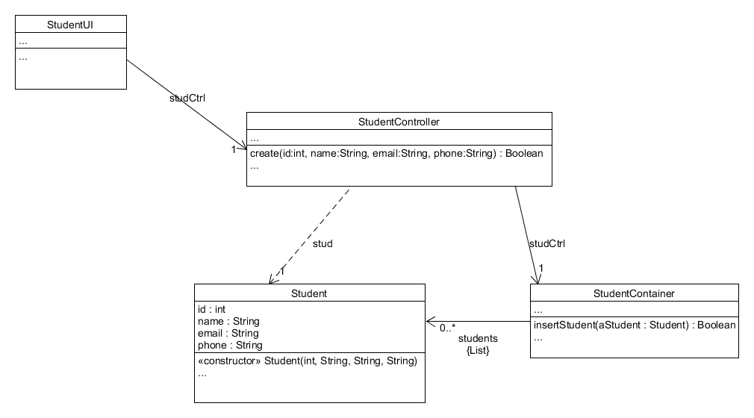
Design Class Diagram

Slide 18
Reflektioner
Gennemgå denne feedback 2 og 2 eller pr projektgruppe
Hvilke feedback emner er aktuelle for jeres 1. semester projekt?
Hvordan vil I undgå problemerne i kommende projekter?

